Slide 1

INSTRUCTIONS
Knapsack Decision Task
Summary. You will be asked to solve 72 instances of the so-called knapsack decision problem. The knapsack problem is a puzzle where a knapsack needs to be filled by selecting a number of items from a large set of items. The aim is to decide whether you
can find a set of items that fit into your knapsack (which has a weight constraint) and achieve (at least) a required total value. For every right answer you will receive $0.7.
Background. This experiment is part of a study exploring human problem solving when problems are hard – even for modern computers. We hope not only to understand how humans approach such problems, but also to develop tools for improved human decision making.

Slide 2
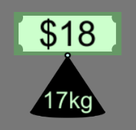
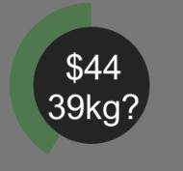
The Task
You will be asked to solve several instances of a computer game based on the knapsack decision problem. In each instance, several items will be displayed on the screen. Each item is made up of a dollar note and a weight. Inside each dollar note you will see the value of the item and, below, you will see the weight of the item. Notice that the size of the dollar note and the weight vary according to value and weight of the item, respectively.
At the centre of the screen you will be shown the weight constraint of the knapsack and a target total value (sum of item values).
The green outer circle is the timer.
Your goal is to decide whether you can find a set of items from all the items available that weigh no more than the weight constraint and have a combined value at least as high as the value target. In other words, is there a combination of items which satisfies that the sum of their weights is at most the weight constraint and whose sum of values is at least the target total value?

Slide 3
Example
Let’s have a look at an example. The following figure shows a screen shot of the task. The explicit question here is whether you can find a set of items whose sum of weights is at most 35kg and whose sum of values is at least $46. What do you think the answer is? (Give it a try before going to the next page).

Slide 4
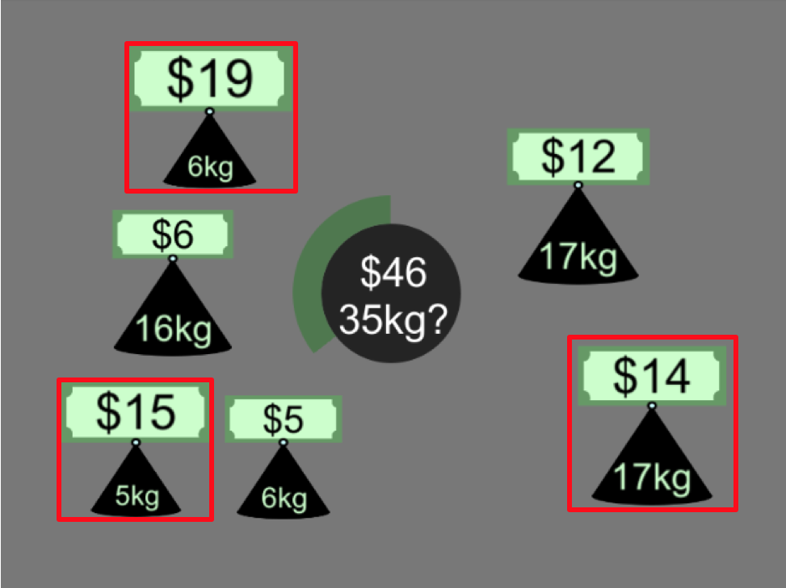
Example
If you pick the 3 items that are indicated by a red square you will obtain:
Total Value = $19 + $15 + $14 = $48
Total Weight = 6kg + 5kg + 17kg = 28kg
This combination (there might be more) satisfies the goal and thus the answer to this particular problem would be YES.
Exercise: Can you find another set of items that achieve the goal?

Slide 5
Example
When the timer of the previous screen runs out you will be prompted to give an answer (YES or NO) by pressing the left or right button key. Remember the question: Is there a set of items from all the items available that weigh no more than the weight constraint and have a combined value at least as high as the value target?
You will only have two seconds to press a button.
Once you have pressed a button the answer is final.
Try to answer all the questions.
The order of the buttons may change from trial to trial:

Slide 6

Example
The following video shows a standard (speeded-up) round where the player selects YES as the answer:
In a trial of the task you will be first shown all the items without the target at the centre. When the timer runs out (outer green circle at the centre), the target will be displayed and a new timer will start. When this timer runs out you will be prompted to give an answer (YES or NO) by pressing the left or right button key.

Slide 7
Example 2
Let’s have a look at another example. What do you think the answer is in this case? Share your answer with the researcher before going to the next page.

Slide 8
Compensation
For this part of the task you will earn $0.7 for each instance solved correctly.

Slide 9
Final Remarks
You are NOT allowed to use any devices such as as mobile phones or calculators. Please turn off your mobile phone now if you haven’t done so.
The use of pen and paper is also NOT allowed.
Please do not hesitate to ask if you have any questions.

